Slide 1
Discovery of the century
Unit 1 Assessment- Gr 5 SS
How do we learn about the past?

Slide 3
Discovery of the Century!
Spectacular
Artifacts found!
Congratulations! You are
an archaeologist on the
verge of a fantastic
Notes:
Congratulations! You are an archaeologist on the verge of a fantastic discovery. At a remote location, you have uncovered some spectacular artifacts! You are sure that if you can set up a dig here you will be as famous as Howard Carter.

Slide 4
Mysterious
Artifacts
Found!
Notes:
This is another option for an overview using transitions to advance through several slides.

Slide 5
A difficult
environment!

Slide 6
Are YOU
the next
Howard Carter?

Slide 7
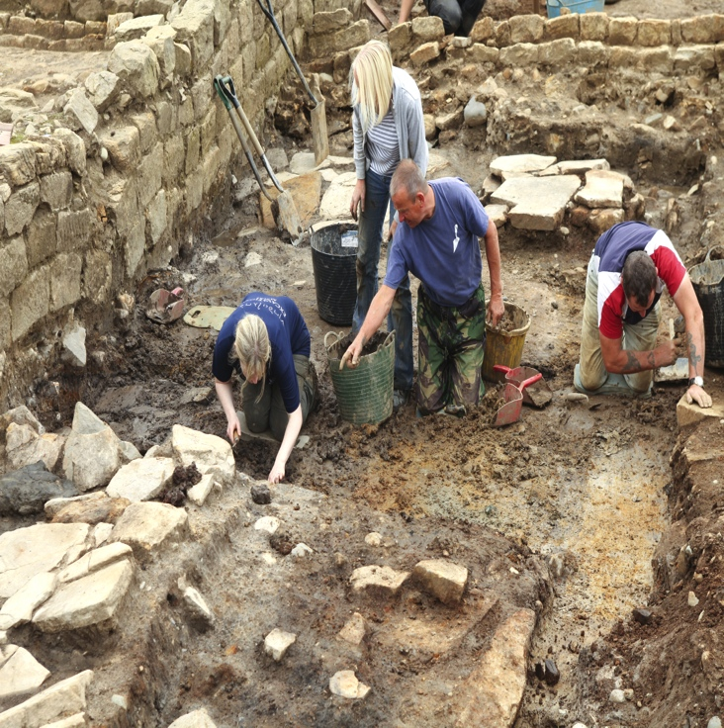
Dig 101

Slide 8
Target:
Create a document to present to the funding committee that thoroughly shows how people such as archaeologists find out about the past.
Notes:
Unfortunately you’ve had bad luck for the last few years and your funding is at $0. You must convince your sponsors that you know what you are doing.

Slide 9
Overview
1
2
Choosing the site
3
Information sources
Article id and estimate time period
Notes:
Consider the following:
1. What do you think you have found and what time period is it likely from?
2. How was your site chosen?
3. What other information sources did you use that led you here?
4. Describe your tools and how you work.
5. What do you consider when you examine the artifacts?
6. How will you preserve your work at the museum?

Slide 10
Overview
4
5
What do you consider in examining artifacts?
6
How will you preserve your work at the museum?
Describe tools and how you work
Notes:
Consider the following:
What do you think you have found and what time period is it likely from?
How was your site chosen?
What other information sources did you use that led you here?
Describe your tools and how you work.
What do you consider when you examine the artifacts?
How will you preserve your work at the museum?

Slide 11
Persuade us !

Slide 12
On the path to success

Slide 13
Working Toward Mastery
Conference to present
Create the
proposal
Project Plan
Plan your
responses
Time Spent

Slide 14
Doing Your Best Work
Evaluation rubric
Timeline

Slide 15
Questions?

